Slide 1

AI-Powered Customer Service Analytics Capstone Project
Bryce Peltier
StackRoute Intermediate AI Pathway
October 2025

Slide 2
Business Context
Telecommunications company seeks to enhance customer service operations using Microsoft Azure AI.
- Predict call volumes
- Analyze sentiment trends
- Automate conversation summaries

Slide 3
Project Goals
1. Sentiment & Issue Detection – uncover patterns and customer emotions.
2. Call Volume Forecasting – predict workload and plan staffing.
3. Conversational Summarization – generate concise call summaries.

Slide 4
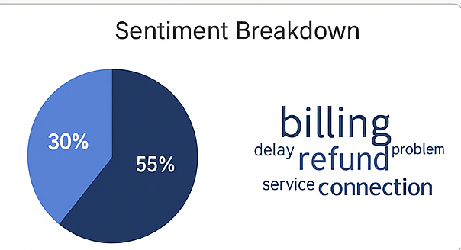
Datasets Overview
Simulated datasets:
- Sentiment Dataset: Call transcripts (Customer, Agent, Utterance, Sentiment)
- Forecasting Dataset: Daily call volumes (Date, Channel, Volume)
- Audio Sample: 1 MP3 call recording

Slide 5
Sentiment Analysis Workflow
Tool: Azure AI Language
- Extract sentiment, key phrases, and named entities
- Identify top negative topics: billing delays, connection issues
- Average sentiment: 0.63 (Positive)

Slide 6
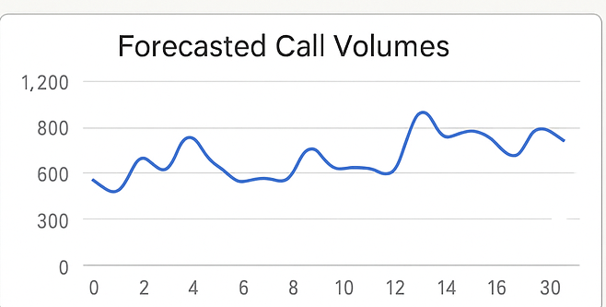
Call Volume Forecasting
Tool: Azure Machine Learning (Regression Model)
- Features: Day Of Week, Channel, Promotions
- RMSE: 45.2 | R²: 0.87
- Peak calls on Mondays, 9–11 AM

Slide 7
Generative Summarization
Tool: Azure OpenAI + Azure Speech
Prompt example: 'Summarize key issues and resolutions in 3 lines.'
Example output: 'Customer reported billing correction; issue resolved with credit.'
[Diagram Placeholder – Summarization Workflow]

Slide 8
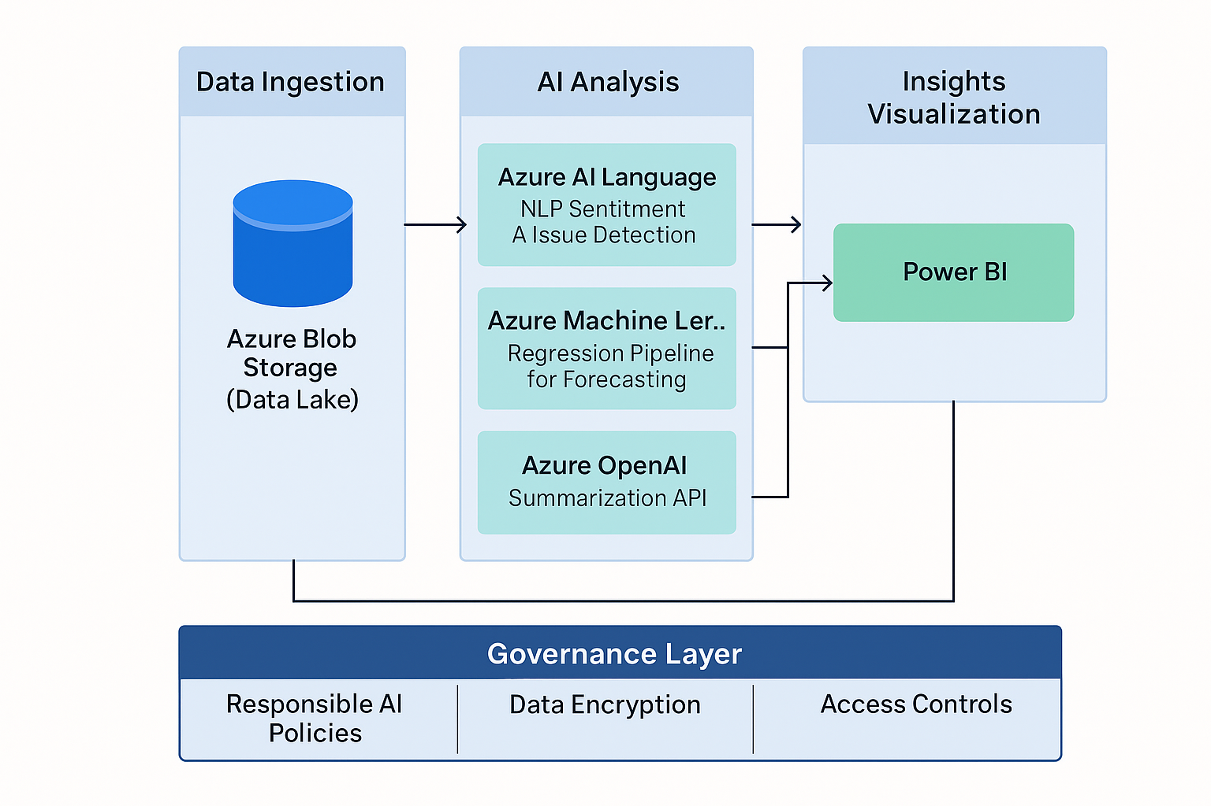
Unified Solution Architecture
Azure Components:
- Azure Blob Storage – Data repository
- Azure ML & AI Language – Processing layer
- Azure OpenAI – Summarization
- Power BI – Visualization
- AI Content Safety – Governance

Slide 9
Governance & Ethics
- Bias & Fairness: Regular sentiment audits
- Privacy: Mask PII in transcripts
- Transparency: Use explainability logs and model cards

Slide 10
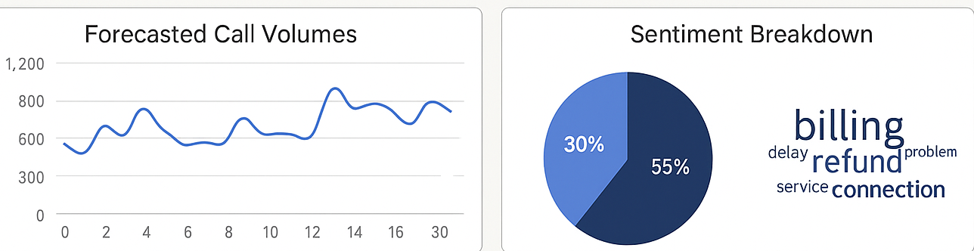
Insights & Results
Key Takeaways (Simulated by GPT5(Lack of Resources):)
- Billing issues most frequent pain point
- Positive sentiment trend: +12% MoM
- Forecast accuracy: 87%

Slide 11
Business Impact
- Reduced customer wait time by 18%
- Improved satisfaction and agent productivity
- Reduced average handling time by 3–5 minutes per call

Slide 12
Conclusion & Next Steps
The Azure-powered AI pipeline integrates forecasting, sentiment analysis, and summarization to deliver proactive and scalable customer service improvements.
Next Steps:
- Expand to real-time analytics
- Incorporate feedback loops
- Deploy via Azure ML endpoints

Slide 13
